Slide 1
Evaluating supervised learning models

Slide 2
Evaluation of models
The process of machine learning is empirical: we try different modeling approaches, with different parameters (e.g., K-NN with different values of K), and eventually select the best performing model configuration.

Slide 3
Evaluation of models

Slide 4
Evaluation of models
We must pre-define the morel evaluation criteria before we start examining models, and then measure the models according to the criteria.

Slide 5
What makes a good model
A model that provides the desired prediction:
In classification:
The model is accurate
Sensitivity to the costs of errors: FP vs. FN
Sometimes classification models are only used for scoring (the probability of Y = 1) – in these cases, accuracy may be totally irrelevant.
Example: what is the probability of experiencing a rare deterioration in a patient’s medical condition?

Slide 6
What makes a good model
A model that provides the desired prediction:
In regression:
In most cases: the prediction is as similar as possible to the actual value (what is similar?)
Maybe: there is a high correlation between predictions and actual values
Sometimes: Provide a conservative prediction (required an estimation of the entire distribution)

Slide 7
What makes a good model
Additional “soft” metrics:
Reasonable training time (bear in mind maintenance)
Flexible to tunings and adaptations
Quick performance on new samples
Stability over time
Easy for implementation
Comprehensible
More…

Slide 8
What makes a good model
But most importantly, is:
Generalization. It generalize to new observations.
Remember… If we can memorize the “answer” to any question we might encounter with, we don’t need machine learning

Slide 9
Measuring generalized performance
Testing should always be done on independent data:
Use an independent hold-out set (train - test \ train – validation - test)
Use cross validation
Do not test your model using the same observations that were used to train the model

Slide 10
Independent test set – an example
Confusion Matrix
Classified As
Red | Blue
1 | 7 | Blue
5 | 0 | Red
Actual

Slide 11
Hold-out splitting
Randomly (or intelligently) split your dataset into mutually exclusive training set and test set (often 2/3 training vs. 1/3 testing)
Leave the test set out: train a SL model based on the training set only
Use the model to generate predictions / estimations on the independent test set
Compare the predictions / estimations with the actual outcome of these observations and extract the appropriate performance measure

Slide 12
Train, test and validation
In realistic scenarios, we typically conduct some experiments: we run several algorithms, with few configurations and select the combination the yields the best result.
When we have that combination, we examine its performance on an independent test set.
But, we also need an independent set in order to compare between the different configurations. This set is called validation set.

Slide 13
Train, test and validation
A possible rule of thumb:
Use 60% of the data for training
20% of the data for validation
20% of the data for testing

Slide 14
Cross validation
Cross validation is an alternative for leave-out validation.

Slide 15
Cross validation
Cross validation require us to train the model k times (more training time), but it gives us more than just a single performance figure.
We tend to use it when the number of input data points is small.

Slide 16
Typical overall architecture

Slide 17
Train, test and validation
Many times, random selection of train, test and validation is the best choice. But, not always.
Two important cases to consider:
Time series: The selection of the different sets must be taken by separation points in time.
The observations can be grouped (e.g., by user or by product): we must split according to the grouping factor, and not simply randomly.

Slide 18
Performance measures for classification
The basis for the most common classification performance metrics is a confusion matrix:
 |  | Predicted
 |  | 0 | 1
Actual | 0 | True Negative (TN) A | False Positive (FP) B
 | 1 | False Negative (FN) C | True Positive (TP) D
If there are more than two classes, we can compute this matrix for each class vs. the others, and then average all matrices

Slide 19
Classification accuracy
Classification accuracy is the expected percentage of samples that will be classified correctly by the model.
Clearly, a 100% accurate model is a perfect predictor.
But…
Do not expect to achieve a perfect predictor (if you got one, you are either solving a trivial problem or you did some mistake on the way).
 |  | Predicted
 |  | 0 | 1
Actual | 0 | True Negative (TN) A | False Positive (FP) B
 | 1 | False Negative (FN) C | True Positive (TP) D

Slide 20
Classification accuracy
Higher accuracy does not necessarily imply better performance
Classes may be highly imbalanced
Buying customers are very rare. Non buying customers are common.
What if 99:1 split? Always say “no” -- 99% default accuracy
Errors have different costs
Cost of eating poisonous mushroom is greater than cost of going hungry
Goals need to be defined by business understanding

Slide 21
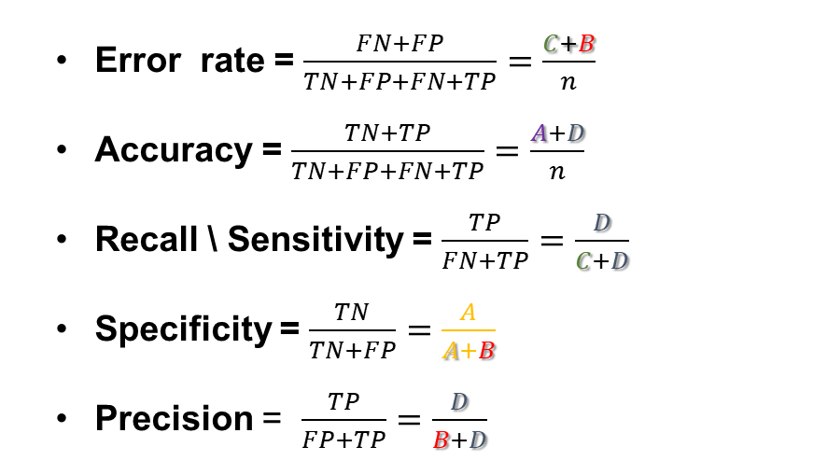
Performance measures based on confusion matrix
Error rate = $\frac{FN+FP}{TN+FP+FN+TP}=\frac{C+B}{n}$
Accuracy = $\frac{TN+TP}{TN+FP+FN+TP}=\frac{A+D}{n}$
Recall \ Sensitivity = $\frac{TP}{FN+TP}=\frac{D}{C+D}$
Specificity = $\frac{TN}{TN+FP}=\frac{A}{A+B}$
Precision = $\frac{TP}{FP+TP}=\frac{D}{B+D}$
 |  | Predicted
 |  | 0 | 1
Actual | 0 | True Negative (TN) A | False Positive (FP) B
 | 1 | False Negative (FN) C | True Positive (TP) D

Slide 22
Recall and precision
In many cases these two measures often show two sides of the coin:
Recall: how many of the positive cases your model catch?
Precision: given a positive prediction, what are the chances that the outcome is indeed positive?
There is an inherent tradeoff between these measures.

Slide 23
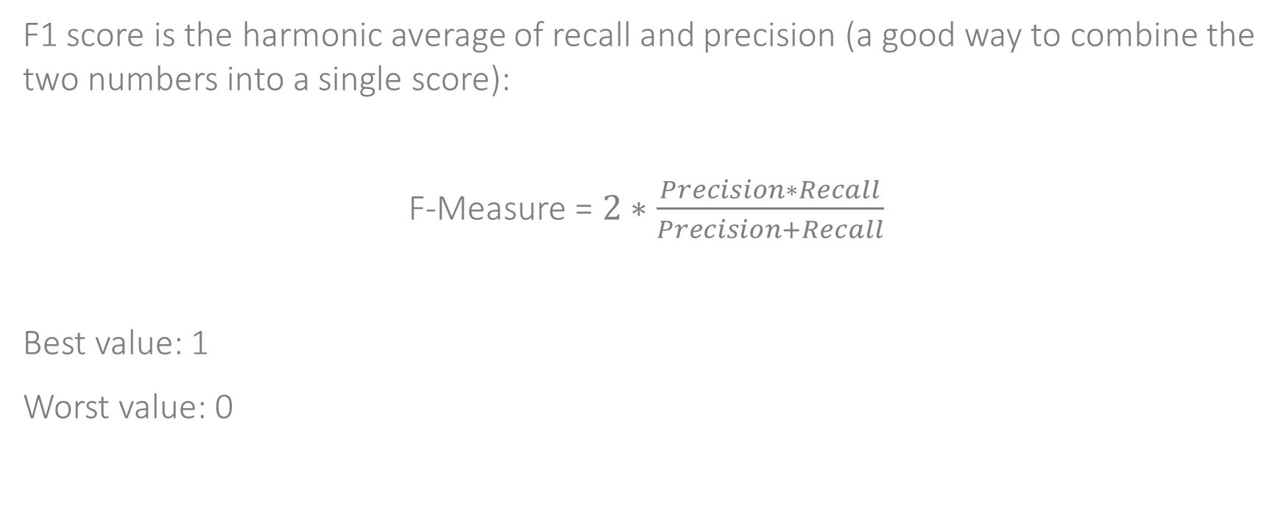
F1 score
F1 score is the harmonic average of recall and precision (a good way to combine the two numbers into a single score):
F-Measure = $2∗\frac{Precision∗Recall}{Precision+Recall}$
Best value: 1
Worst value: 0

Slide 24
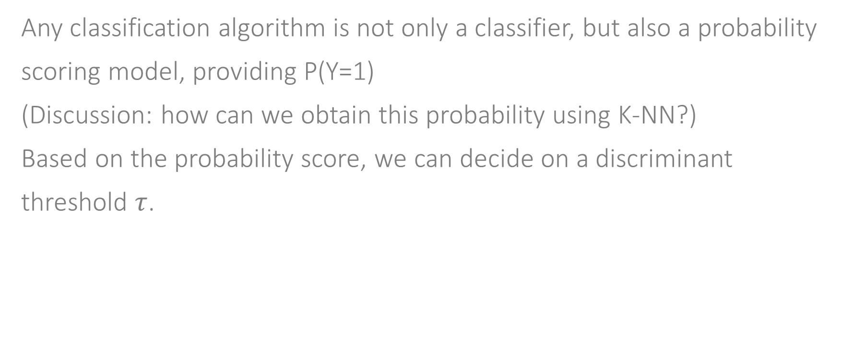
ROC curve
Any classification algorithm is not only a classifier, but also a probability scoring model, providing P(Y=1)
(Discussion: how can we obtain this probability using K-NN?)
Based on the probability score, we can decide on a discriminant threshold $τ$.

Slide 25
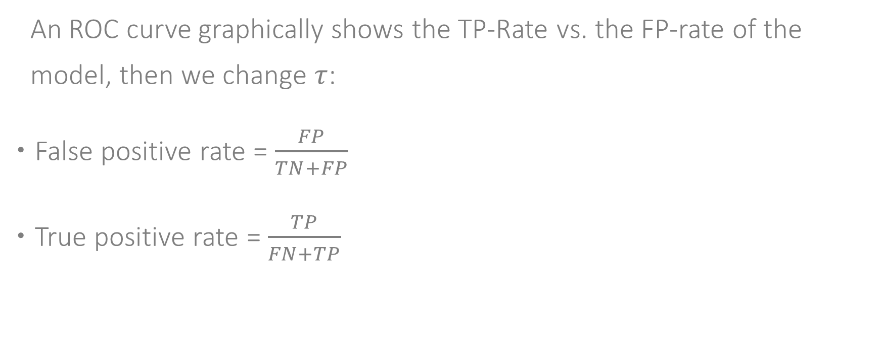
ROC curve
An ROC curve graphically shows the TP-Rate vs. the FP-rate of the model, then we change $τ$:
False positive rate = $\frac{FP}{TN+FP}$
True positive rate = $\frac{TP}{FN+TP}$
 |  | Predicted
 |  | 0 | 1
Actual | 0 | True Negative (TN) A | False Positive (FP) B
 | 1 | False Negative (FN) C | True Positive (TP) D

Slide 26
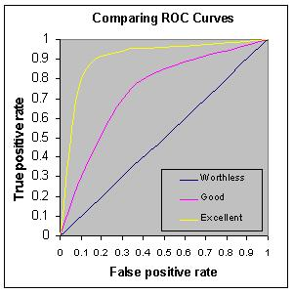
ROC curve

Slide 27
ROC AUC
AUC = Area Under the Curve
Worthless model = ROC AUC = 0.5
Perfect model = ROC AUC = 1
The higher is the ROC AUC, the better are the predictive capabilities of the model.

Slide 28
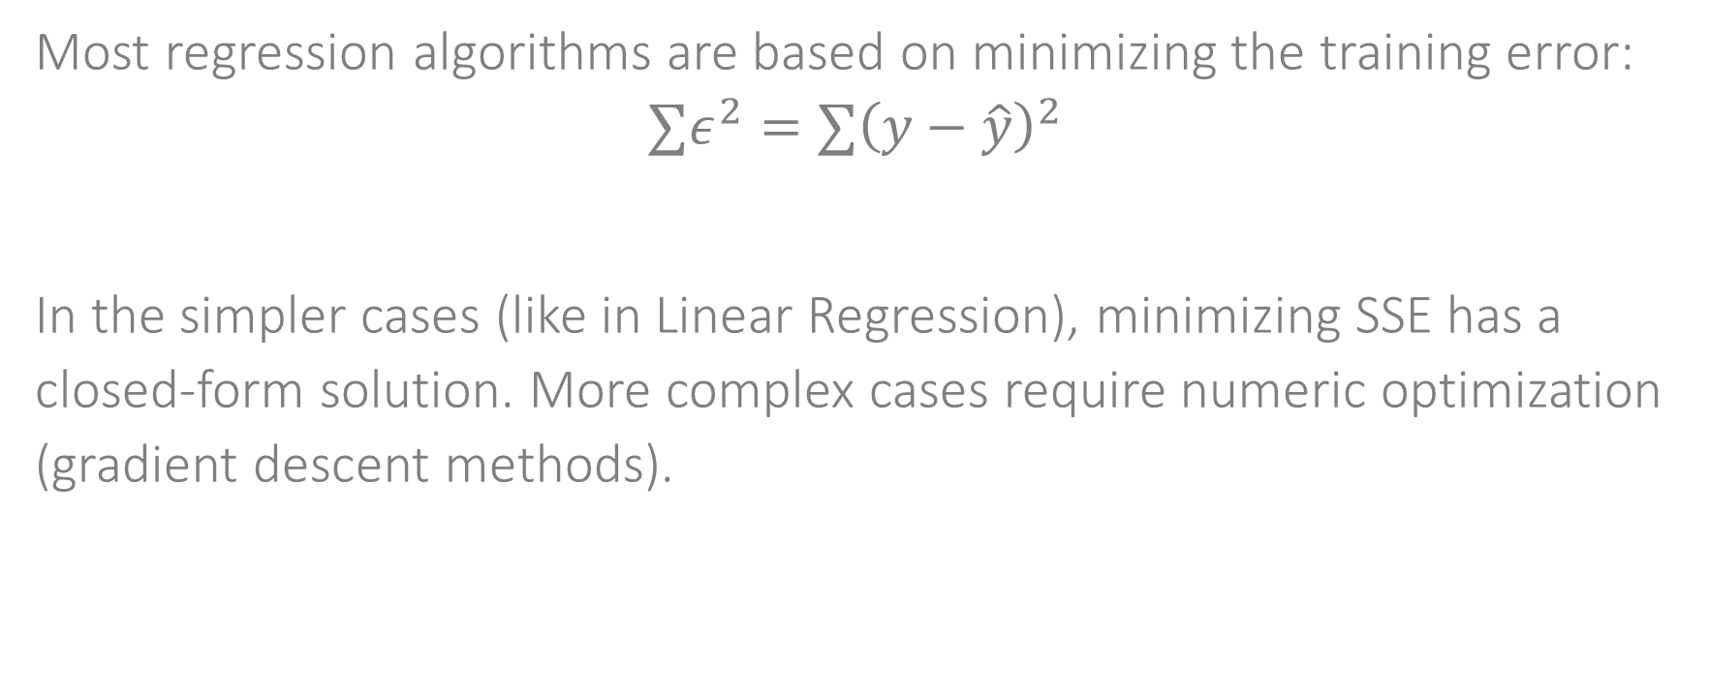
Performance measures for regression
Most regression algorithms are based on minimizing the training error:
$$∑ε^{2}=∑{\left(y−\hat{y}\right)}^{2}$$
In the simpler cases (like in Linear Regression), minimizing SSE has a closed-form solution. More complex cases require numeric optimization (gradient descent methods).

Slide 29
Performance measures for regression
Additional related measures: MAE, MAPE, MAE, Correlation
Different performance measures might have different meaning in different cases.
Is +- 1$ is a big or a small MAE?
Is +- 605 is a big or a small MAPE?
In order to fully understand the performance of a model, you need to fully understand the distribution of the error.

Slide 30
Online performance measures
When we used performance measure that was calculated on independent test set, we assume that the distribution over our dataset reflects the distribution over the entire population. Also called Offline testing.
In some cases this is clearly not the case.
Example: Risk Scoring
Input Dataset: List of loans, some of which are defaults.
The distribution of the input dataset depends on the risk scoring policy, currently held by the company.
Therefor, it is often the case that you must run online testing in order to know the real performance of your model. Also called Online or A\B testing.

Slide 31
Evaluating supervised learning models

